Slide 1
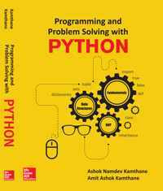
Programming and problem solving with python
Chapter 5
Loop Control Statements
Copyright © 2018 McGraw Hill Education, All Rights Reserved.
PROPRIETARY MATERIAL © 2018 The McGraw Hill Education, Inc. All rights reserved. No part of this PowerPoint slide may be displayed, reproduced or distributed in any form or by any means, without the prior written permission of the publisher, or used beyond the limited distribution to teachers and educators permitted by McGraw Hill for their individual course preparation. If you are a student using this PowerPoint slide, you are using it without permission.

Slide 2
Introduction
Python Supports two types of loop controlled statements.
a) while Loop (Condition Controlled Loop)
b) For Loop (Count Controlled Loop)
The while loop is condition controlled loop an it is controlled by true or false conditions.
Whereas the for loop is a count controlled loop which repeats for specified number of times.

Slide 3
The While Loop
The while loop is frequently used in programming for repeated execution of statement/s in a loop.
It executes sequence of statements repeatedly as long as condition remains true.
Syntax of while loop is as
The reserved keyword while begins with the while statement.
The test-condition is a Boolean expression.
The colon (:) must follow the test-condition i.e. the while statement is terminated with colon(:)
The statement(s) within while loop will be executed till the condition is true
while test-condition: #Loop Body statement(s)

Slide 4
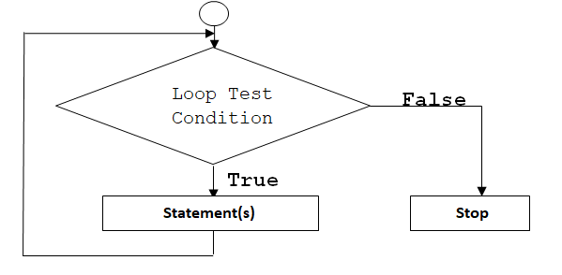
Flow chart of While Loop

Slide 5
Program on While Loop
Program to print the numbers from one to five using while loop
count=0 #initialize the counter while count<=5: # Test condition print("Count = ",count) # print the value of count count=count+1 # Increment the value of count by 1 Output: Count = 0 Count = 1 Count = 2 Count = 3 Count = 4 Count = 5

Slide 6
The range() function
The range() is a in build function.
It is used to generate the list of integers.
The range function has one, two or three parameters.
The general form of the range function is as follows
range(begin, end, step)
Whereas,
The begin is the first beginning number in the sequence at which the list starts.
The end is the limit i.e. the last number in sequence.
The step is the difference between the each number in sequence.

Slide 7
Examples of range() function
Creates the list of 5 integers
To create a list of integers from 1 to 20 with a difference of 2 between two successive integers
>>> list(range(1,6)) [1,2,3,4,5]
>>> list(range(1,20,2)) [1, 3, 5, 7, 9, 11, 13, 15, 17, 19]

Slide 8
The for loop
Python for loop iterates through a sequence of objects i.e. it iterates through each value in a sequence.
Where sequence of object holds multiple items of data stored one after another.
The syntax of for loop is as follows:
Thus, for loop is a python statement which repeats a group of statements for a specified number of times.
for var in sequence: statement(s) ……………………………… …………………………… ………………………………

Slide 9
Program on for loop
Write a program by using for loop to print numbers from 1 to 5.
for x in range(0,5): print(x,end=' ') Output 0 1 2 3 4

Slide 10
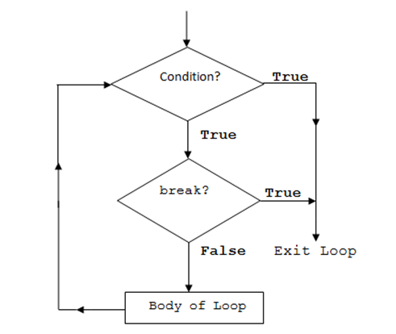
The break Statement
The keyword break allows the programmer to terminate the loop.
When the break statement is encountered inside a loop, the loop is immediately terminated and program control automatically goes to the first statement.
Flow chart of break statement

Slide 11
Working of break in while and for loop
Working of break in while loop
Working of break in for loop
while test-Boolean-expression: body of while if condition: break body of while Statement(s)
for var in sequence: body of for if condition: break body of for statement(s)

Slide 12
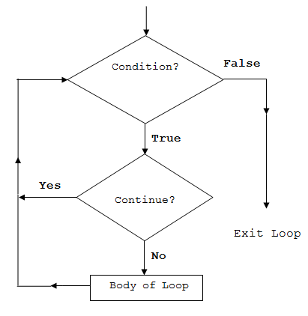
The continue Statement
The continue statement is exactly opposite of the break statement.
When continue is encountered within the loop, the remaining statements within the body are skipped but the loop condition is checked to see if the loop should continue or exited.
Flow chart of continue

Slide 13
Working of continue in while and for loop
Working of continue in while loop
Working of continue in for loop
while test-Boolean-expression: body of while if condition: continue body of while Statement(s)
for var in sequence: body of for if condition: continue body of for statement(s)

Slide 14
Conclusion
The loops are used to repeat the same code multiple times.
Various loops such as for, and while have been discussed.
The while loop is a condition controlled loop where as for loop is a count controlled loop.
The break statement is used to terminate from the loop.
Where as continue statement is used to skip the current iteration and continues with the next iteration.

